Slide 1
Discussion 7: Asymptotic Analysis
Christine Zhou

Slide 2
Agenda
Announcements
Recursive Runtime
Worksheet

Slide 3
Announcements
Remember to commit frequently!
HW4 was due yesterday
Proj1 is due this Friday!
Extra OH on Wednesday 6-8PM, Thursday 7-9PM, most likely in the labs!
Extra credit opportunity: Mid-semester survey! Keep your eyes peeled
Advising Sessions: tinyurl.com/cs61b-advising
CS 370 Signups!
Discussion survey: tinyurl.com/disc7cz

Slide 4
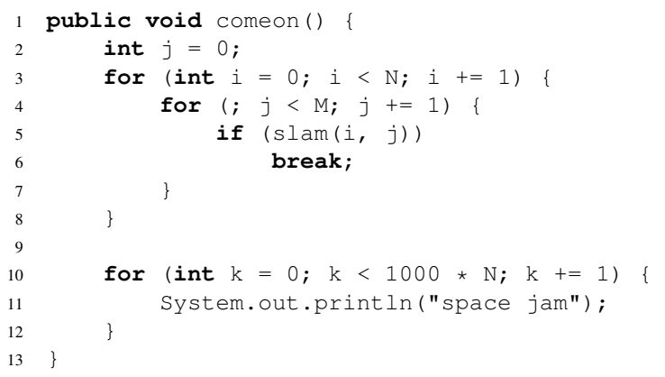
1 More Running Time

Slide 5
Practice Problem
public void hello(int n) {
if (n == 0) {
return;
} else {
for (int i = 0; i < 10000000; i += 1) {
System.out.println(“hello”);
}
hello(n-1);
}
}
Let’s draw the “work done” tree!

Slide 6
2 Recursive Running Time
There are some typos on the discussion sheet, sorry!!
public void andslam(int N) { if (N > 0) {
for (int i = 0; i < N; i += 1) {
System.out.println(“bigballer.jpg”);
}
andslam(N/2);
}
}

Slide 7
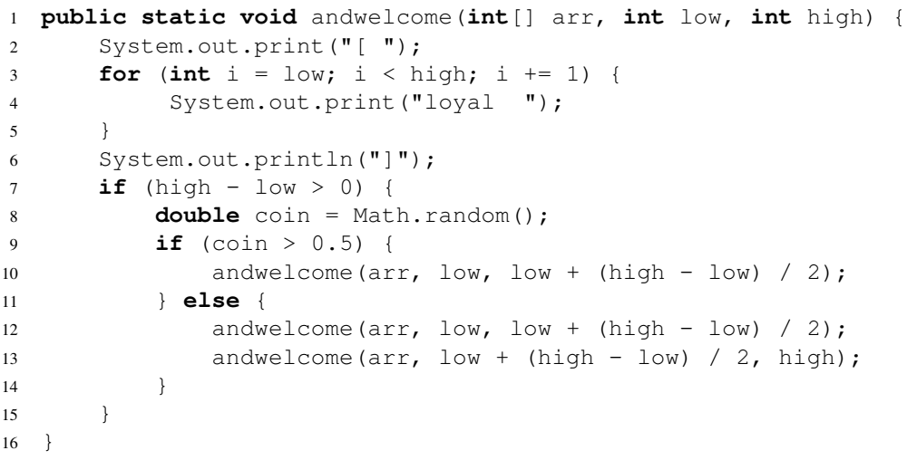
2 Recursive Running Time

Slide 8
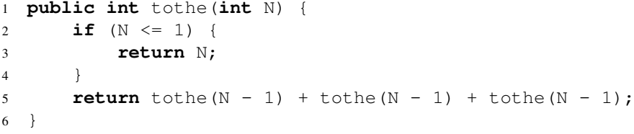
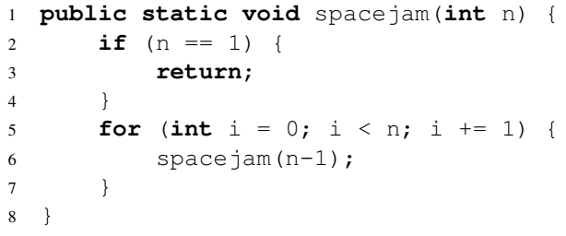
2 Recursive Running Time

Slide 9
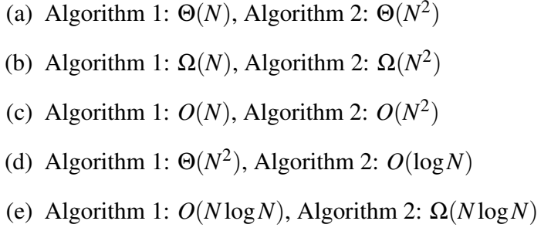
3 Hey you watchu gon do?
a) Algorithm 1
b) Neither
c) Neither
d) Algorithm 2
e) Neither

Slide 10
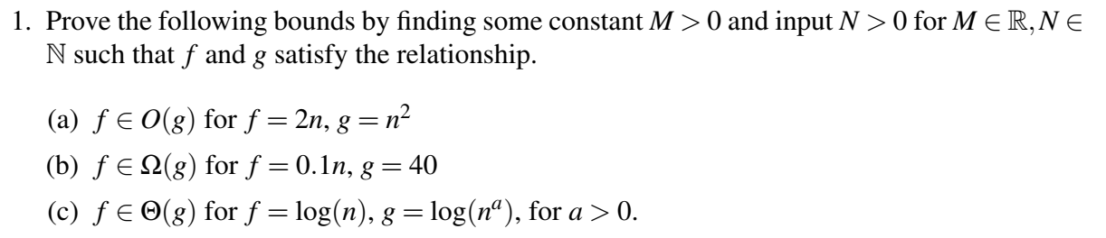




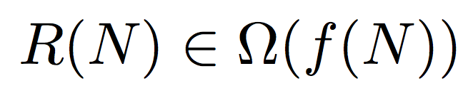
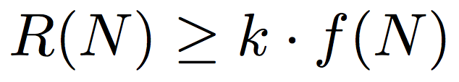
Big Ballin’ Bounds
Big Theta
Big O
Big Omega

Slide 11
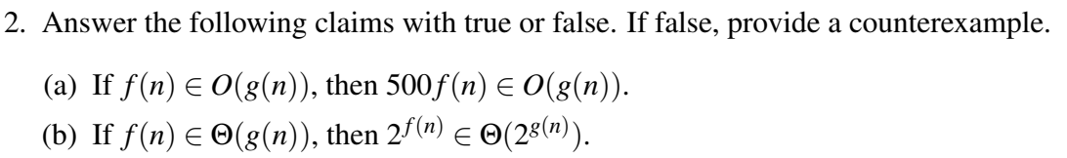
4 Big Ballin’ Bounds

